Slide 1
Getting started
Guide for users with a corporate directory
Olvid Support
Contact Olvid Support
Support on YouTube
support@olvid.io

Slide 2
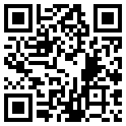
1. Install Olvid
Download Olvid from your device's store
or
Scan this QR code with your camera to find Olvid in your device's store.
Support: https://olvid.io/faq/how-to-install-olvid/

Slide 3
2. Create your Olvid profile
2 situations
You didn't have Olvid
CREATE
your professional profile
OR
You already had Olvid
SWITCH to
your professional profile

Slide 4
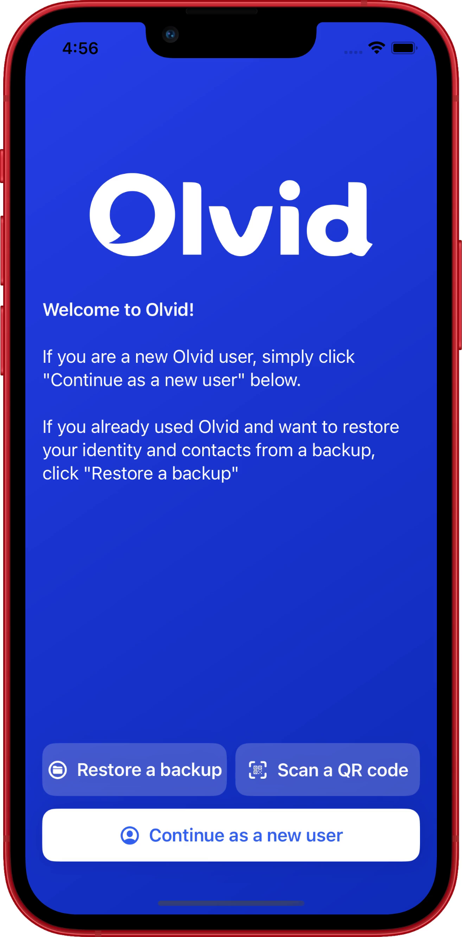
CREATE your Olvid professional profile
if you didn't have Olvid
Insert here the QR code and
the configuration link of your
your company’s directory.
Your administrator creates them in
the Olvid administration console
of your company.
Click on the link received from your administrator OR Open Olvid and tap Scan a QR code, then scan the QR code on the left.

Slide 5
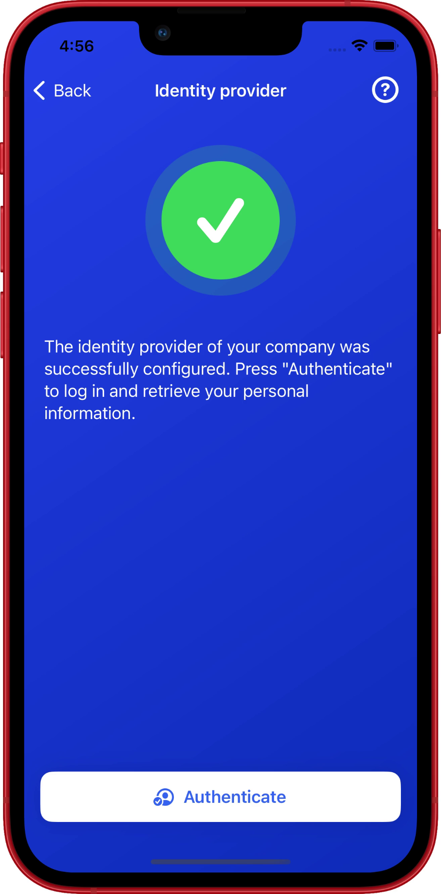
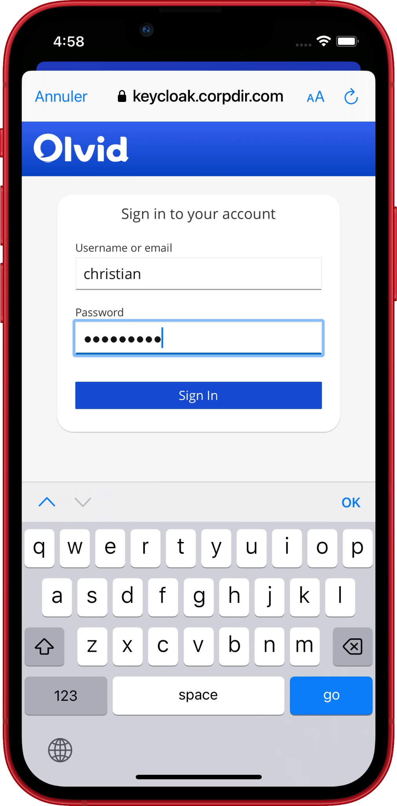
CREATE your Olvid professional profile
if you didn't have Olvid
Tap Authenticate.
Enter your username and password provided by your administrator.
Tap Sign In.
Check your name and tap Create my ID.
That's it! You can now add contacts from your company’s directory.

Slide 6
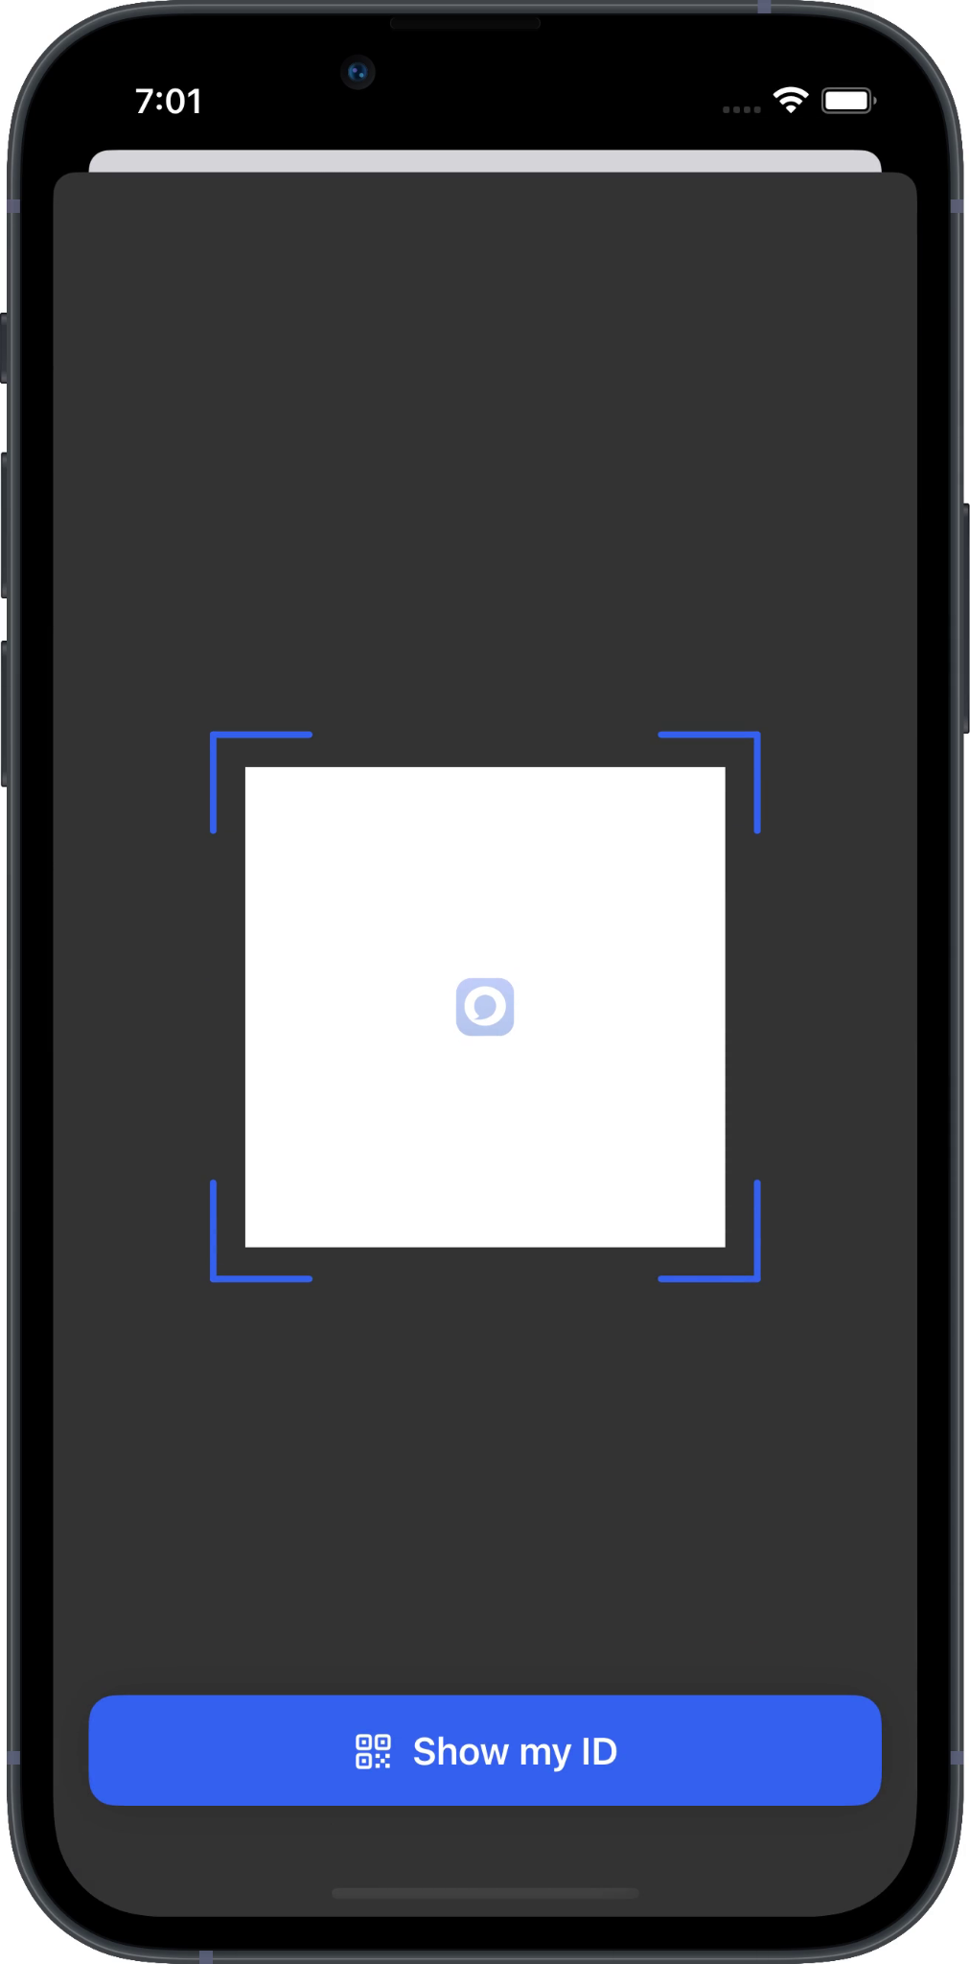
SWITCH to your Olvid professional profile
if you already had Olvid
Insert here the QR code and
the configuration link of your
your company’s directory.
Your administrator creates them in
the Olvid administration console
of your company.
Click on the link received from your administrator OR Open Olvid and tap then Scan a QR code, then scan the QR code on the left.

Slide 7
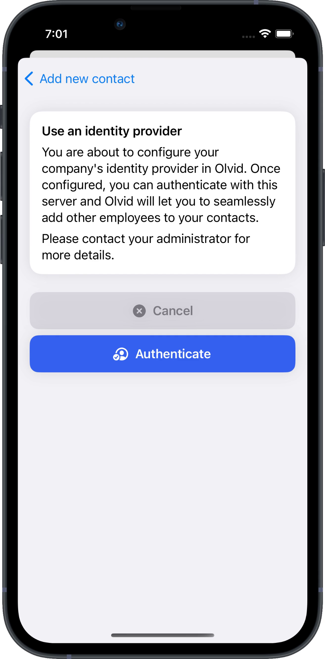
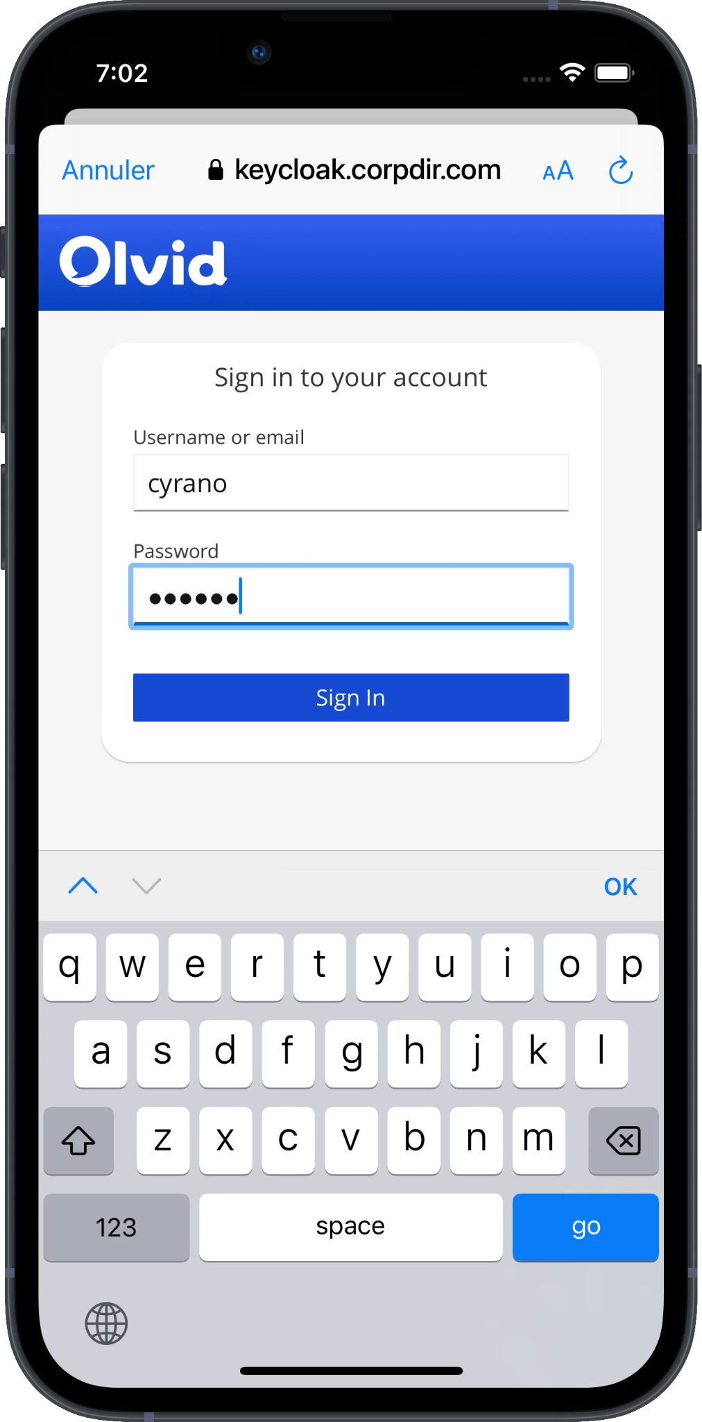
SWITCH to your Olvid professional profile
if you already had Olvid
Tap Authenticate.
Enter your username and password provided by your administrator.
Tap Sign In.
Check your name and tap Switch to a managed ID.
That's it! You can now add contacts from your company’s directory.

Slide 8
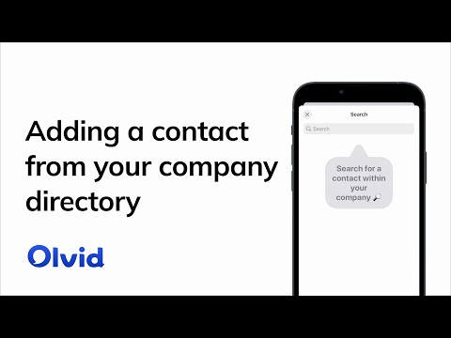
3. Add contacts from your company’s directory
Tap
Tap Directory.
Tap the search box. The contacts appear.
Refine your search.
Tap the name of the contact you want to add.
Confirm by Tapping Add to contacts. A secure channel is created.
Tap Chat.
Support: https://olvid.io/faq/add-contacts-from-your-company-directory
https://youtu.be/gI4fhXQizUo

Slide 9
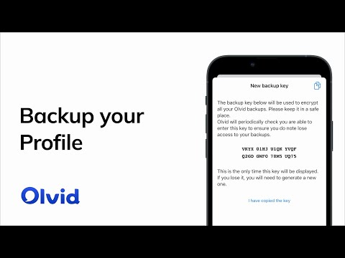
4. Backup your profiles
In anticipation of a change or loss of device, only a backup of your Olvid profiles with your original device will allow you to restore them on your next device.
Support:
https://olvid.io/faq/backup-your-profiles
https://youtu.be/6rTO2EhwiQg

Slide 10
Video Tutorials
Olvid Support
‹#›

Slide 11
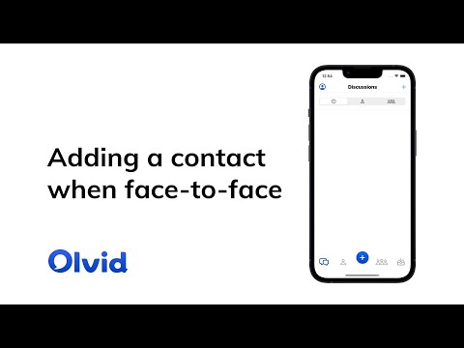
Add contacts face-to-face
https://youtu.be/kkrbMhxSOKQ
Support: https://olvid.io/faq/add-contacts-face-to-face

Slide 12
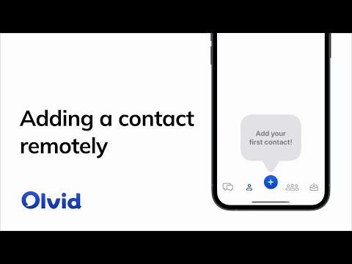
Add contacts remotely
https://youtu.be/s0xy9cw30j4
Support: https://olvid.io/faq/add-contacts-remotely

Slide 13
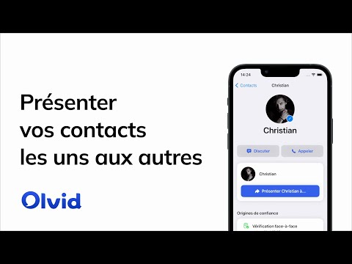
Introduce your contacts to each other
https://youtu.be/BFSwYXFo-K8 (FR)
Support: https://olvid.io/faq/introduce-your-contacts-to-each-other

Slide 14
Olvid Support
Support-FAQ https://olvid.io/faq
Other manuals
https://olvid.io/manuals
Contact Olvid Support https://olvid.io/faq/contact-olvid-support
For any questions afterwards
support@olvid.io

